Slide 1
Lecture 6 – Breakdown of Steps for Designing Static Model:
COMP 3700: Modeling and Design
From Conceptual Static Model to Software System Context Class Diagram with Stereotypes
Gomaa, 2011

Slide 2
Steps for Designing Static Model
Construct the conceptual static model for the system
Build the hardware/software system context class diagram
Build the software system context class diagram
Add the external class stereotypes to the system software context class diagram

Slide 3
Participation Activity 4 & Preparation Activity 5: In-Class Static Modeling Exercise
Working in the same in-class groups, follow the four step algorithm for creating a software context class diagram with stereotypes for the Shelby County Bill Pay system you’ve been modeling
Upload the group’s conceptual static model and software context class diagram with stereotypes in Canvas
Be sure that at least one member of your group brings copies of the conceptual static model and software context class diagram to class on Tuesday.
Additionally, ensure that at least one member of your group brings the latest version of your group’s use case model (i.e., use case diagram, use case descriptions, and activity diagrams) to class on Tuesday.
On Tuesday, you will peer review each other’s conceptual static models and software context class diagrams with stereotypes

Slide 4
Steps for Designing Static Model
Construct the conceptual static model for the system

Slide 5
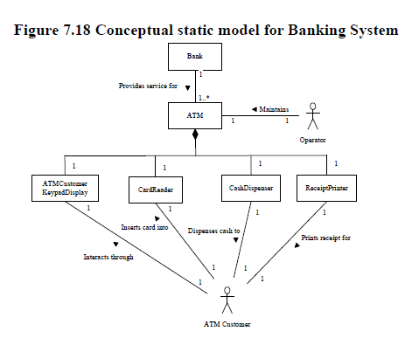
Steps for Designing Static Model
From the problem description and use case model (i.e., use case diagram, use case descriptions, and use case activity diagrams), construct the conceptual static model for the system
Identify physical classes (i.e, classes that can be seen and touched – devices, sensors, etc.)
Identify the associations between the actors, physical classes, and software system (verb descriptions on the lines between those entities)
Describe/depict the hierarchies (composition/aggregation/generalization/specialization)
Describe multiplicity of Associations

Slide 6
Steps for Designing Static Model
From the problem description and use case model (i.e., use case diagram, use case descriptions, and use case activity diagrams), construct the conceptual static model for the system
Identify physical classes (i.e, classes that can be seen and touched – devices, sensors, etc.)
Identify the associations between the actors, physical classes, and software system (verb descriptions on the lines between those entities)
Describe/depict the hierarchies (composition/aggregation/generalization/specialization)
Describe multiplicity of Associations

Slide 7
Steps for Designing Static Model
From the problem description and use case model (i.e., use case diagram, use case descriptions, and use case activity diagrams), construct the conceptual static model for the system
Identify physical classes (i.e, classes that can be seen and touched – devices, sensors, etc.)
Identify the associations between the actors, physical classes, and software system (verb descriptions on the lines between those entities)
Describe/depict the hierarchies (composition/aggregation/generalization/specialization)
Describe multiplicity of Associations

Slide 8
Steps for Designing Static Model
From the problem description and use case model (i.e., use case diagram, use case descriptions, and use case activity diagrams), construct the conceptual static model for the system
Identify physical classes (i.e, classes that can be seen and touched – devices, sensors, etc.)
Identify the associations between the actors, physical classes, and software system (verb descriptions on the lines between those entities)
Describe/depict the hierarchies (composition/aggregation/generalization/specialization)
Describe multiplicity of Associations

Slide 9
Steps for Designing Static Model
Construct the conceptual static model for the system
Build the hardware/software system context class diagram

Slide 10
Steps for Designing Static Model
From the conceptual static model, build different views into the system through the context class diagram
Build the hardware/software system context class diagram
Depict the hardware/software system as an aggregate class (i.e., black box) with the stereotype <<system>>
Depict the primary and secondary actors
Identify the associations between the actors and the hardware/software system depicted as a black box (verb descriptions on the lines between those entities)
Describe multiplicity of Associations

Slide 11
Steps for Designing Static Model
From the conceptual static model, build different views into the system through the context class diagram
Build the hardware/software system context class diagram
Depict the hardware/software system as an aggregate class (i.e., black box) with the stereotype <<system>>
Depict the primary and secondary actors
Identify the associations between the actors and the hardware/software system depicted as a black box (verb descriptions on the lines between those entities)
Describe multiplicity of Associations

Slide 12
Steps for Designing Static Model
From the conceptual static model, build different views into the system through the context class diagram
Build the hardware/software system context class diagram
Depict the hardware/software system as an aggregate class (i.e., black box) with the stereotype <<system>>
Depict the primary and secondary actors
Identify the associations between the actors and the hardware/software system depicted as a black box (verb descriptions on the lines between those entities)
Describe multiplicity of Associations

Slide 13
Steps for Designing Static Model
Construct the conceptual static model for the system
Build the hardware/software system context class diagram
Build the software system context class diagram

Slide 14
Steps for Designing Static Model
From the hardware/software system context class diagram and the conceptual model
Build the software system context class diagram
Depict the software system (only) as an aggregate class (i.e., black box)
Depict the associations between the actors, physical classes, and software system (verb descriptions on the lines between those entities)
Depict the multiplicity of Associations

Slide 15
Steps for Designing Static Model
From the hardware/software system context class diagram
Build the software system context class diagram
Depict the software system (only) as an aggregate class (i.e., black box)
Depict the associations between the actors, physical classes, and software system (verb descriptions on the lines between those entities)
Depict the multiplicity of Associations

Slide 16
Steps for Designing Static Model
From the hardware/software system context class diagram
Build the software system context class diagram
Depict the software system (only) as an aggregate class (i.e., black box)
Depict the associations between the actors, physical classes, and software system (verb descriptions on the lines between those entities)
Depict the multiplicity of Associations

Slide 17
Steps for Designing Static Model
Construct the conceptual static model for the system
Build the hardware/software system context class diagram
Build the software system context class diagram
Add the external class stereotypes to the system software context class diagram

Slide 18
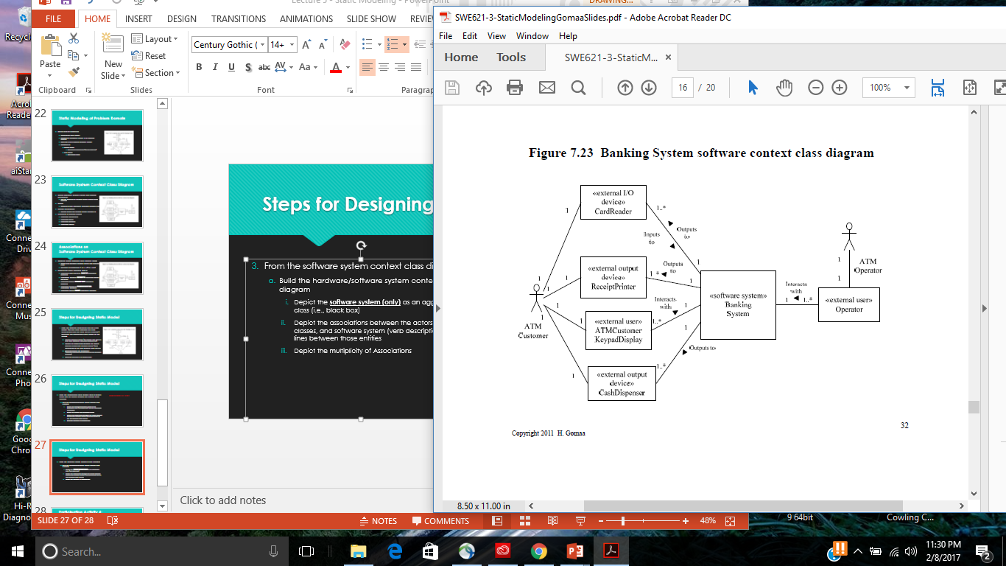
Steps for Designing Static Model
Add the external class stereotypes to the system software context class diagram
Use the stereotype classification on page 108 in your text

Slide 19
Participation Activity 4 & Preparation Activity 5: Peer-Review of Static Models
Remaining in in-class groups, peer review another group’s Static Model
Start from Use Case Model
Give feedback
Conceptual Static Model
Hardware/Software System Context Class Diagram
Software System Context Class Diagram
Write feedback directly on group artifacts
After you have given feedback, review the feedback your group received and iterate on your group’s Static Model
Upload your group’s updated Static Model to Canvas
Updated Conceptual Static Model
Hardware/Software System Context Class Diagram
Software System Context Class Diagram

